Slide 1
Database Recovery Techniques

Slide 2
Outline
Databases Recovery
  1. Purpose of Database Recovery
  2. Types of Failure
  3 . Transaction Log
  4 . Data Updates
  5. Data Caching
  6 . Transaction Roll-back (Undo) and Roll-Forward
  7 . Checkpointing
  8 . Recovery schemes
  9 . ARIES Recovery Scheme
  10. Recovery in Multidatabase System

Slide 3
Database Recovery
1 Purpose of Database Recovery
  To bring the database into the last consistent state, which existed prior to the failure.
  To preserve transaction properties (Atomicity, Consistency, Isolation and Durability).
Example:
  If the system crashes before a fund transfer transaction completes its execution, then either one or both accounts may have incorrect value. Thus, the database must be restored to the state before the transaction modified any of the accounts.

Slide 4
Database Recovery
2 Types of Failure
  The database may become unavailable for use due to
    Transaction failure: Transactions may fail because of incorrect input, deadlock, incorrect synchronization.
    System failure: System may fail because of addressing error, application error, operating system fault, RAM failure, etc.
    Media failure: Disk head crash, power disruption, etc.

Slide 5
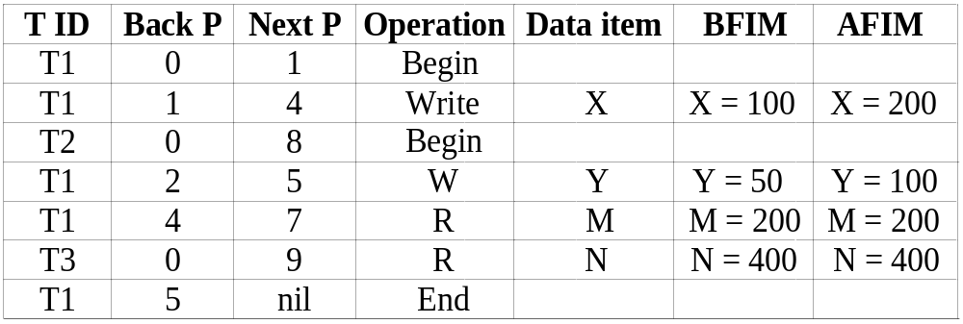
Database Recovery
3 Transaction Log
  For recovery from any type of failure data values prior to modification (BFIM - BeFore Image) and the new value after modification (AFIM – AFter Image) are required.
  These values and other information is stored in a sequential file called Transaction log. A sample log is given below. Back P and Next P point to the previous and next log records of the same transaction.

Slide 6
Database Recovery
4 Data Update
  Immediate Update: As soon as a data item is modified in cache, the disk copy is updated.
  Deferred Update: All modified data items in the cache is written either after a transaction ends its execution or after a fixed number of transactions have completed their execution.
  Shadow update: The modified version of a data item does not overwrite its disk copy but is written at a separate disk location.
  In-place update: The disk version of the data item is overwritten by the cache version.

Slide 7
Database Recovery
5 Data Caching
  Data items to be modified are first stored into database cache by the Cache Manager (CM) and after modification they are flushed (written) to the disk.
  The flushing is controlled by Modified/Dirty and Pin-Unpin bits.
    Pin-Unpin: Instructs the operating system not to flush the data item.
    Modified: Indicates the AFIM of the data item.

Slide 8
Database Recovery
6 Transaction Roll-back (Undo) and Roll-Forward (Redo)
  To maintain atomicity, a transaction’s operations are redone or undone.
    Undo: Restore all BFIMs on to disk (Remove all AFIMs).
    Redo: Restore all AFIMs on to disk.
  Database recovery is achieved either by performing only Undos or only Redos or by a combination of the two. These operations are recorded in the log as they happen.

Slide 9
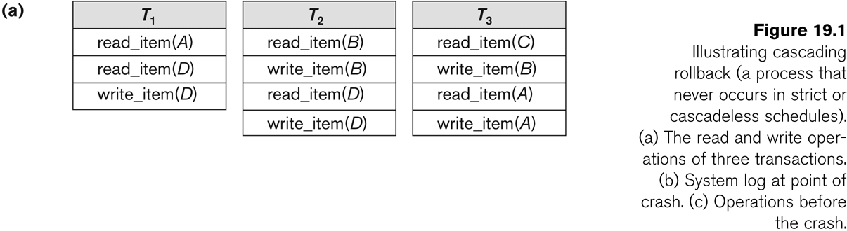
Database Recovery

Slide 10
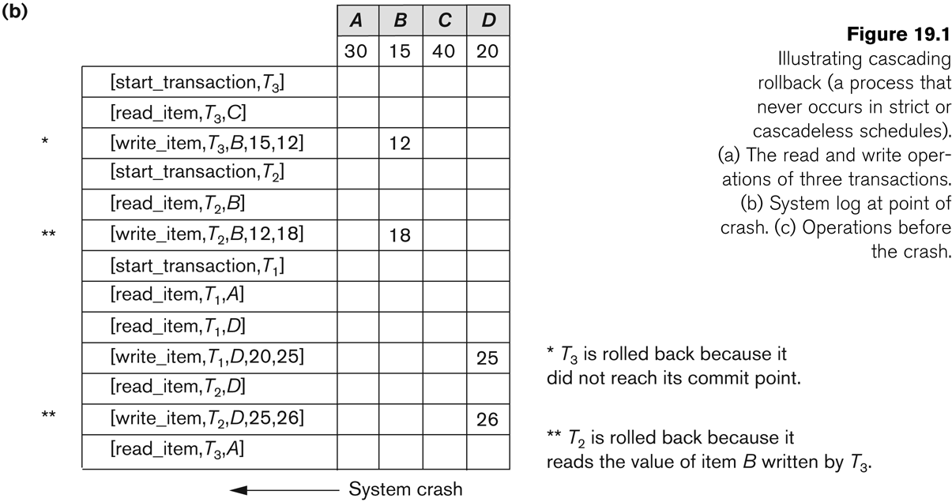
Database Recovery

Slide 11
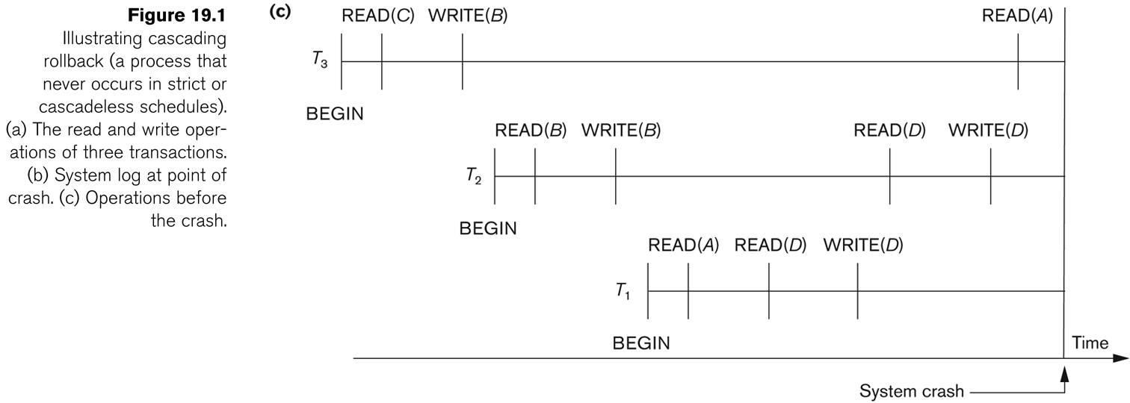
Database Recovery
Roll-back: One execution of T1, T2 and T3 as recorded in the log.

Slide 12
Database Recovery
Write-Ahead Logging
When in-place update (immediate or deferred) is used then log is necessary for recovery and it must be available to recovery manager. This is achieved by Write-Ahead Logging (WAL) protocol. WAL states that
  For Undo: Before a data item’s AFIM is flushed to the database disk (overwriting the BFIM) its BFIM must be written to the log and the log must be saved on a stable store (log disk).
  For Redo: Before a transaction executes its commit operation, all its AFIMs must be written to the log and the log must be saved on a stable store.

Slide 13
Database Recovery
7 Checkpointing
  Time to time (randomly or under some criteria) the database flushes its buffer to database disk to minimize the task of recovery. The following steps defines a checkpoint operation:
    Suspend execution of transactions temporarily.
    Force write modified buffer data to disk.
    Write a [checkpoint] record to the log, save the log to disk.
    Resume normal transaction execution.
  During recovery redo or undo is required to transactions appearing after [checkpoint] record.

Slide 14
Database Recovery
Steal/No-Steal and Force/No-Force
  Possible ways for flushing database cache to database disk:
    Steal: Cache can be flushed before transaction commits.
    No-Steal: Cache cannot be flushed before transaction commit.
    Force: Cache is immediately flushed (forced) to disk.
    No-Force: Cache is deferred until transaction commits
  These give rise to four different ways for handling recovery:
    Steal/No-Force (Undo/Redo)
    Steal/Force (Undo/No-redo)
    No-Steal/No-Force (Redo/No-undo)
    No-Steal/Force (Undo/No-redo)

Slide 15
Database Recovery
8 Recovery Scheme
Deferred Update (No Undo/Redo)
  The data update goes as follows:
  A set of transactions records their updates in the log.
  At commit point under WAL scheme these updates are saved on database disk.
  After reboot from a failure the log is used to redo all the transactions affected by this failure. No undo is required because no AFIM is flushed to the disk before a transaction commits.

Slide 16
Database Recovery
Recovery Techniques Based on Immediate Update
Undo/No-redo Algorithm
  In this algorithm AFIMs of a transaction are flushed to the database disk under WAL before it commits.
  For this reason the recovery manager undoes all transactions during recovery.
  No transaction is redone.
  It is possible that a transaction might have completed execution and ready to commit but this transaction is also undone.

Slide 17
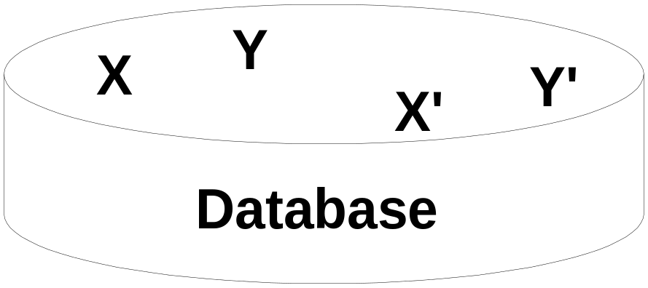
Database Recovery
Shadow Paging
The AFIM does not overwrite its BFIM but recorded at another place on the disk. Thus, at any time a data item has AFIM and BFIM (Shadow copy of the data item) at two different places on the disk.
X and Y: Shadow copies of data items
X' and Y': Current copies of data items

Slide 18
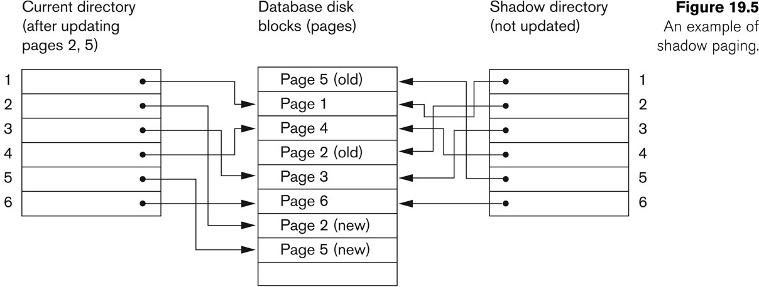
Database Recovery
Shadow Paging
To manage access of data items by concurrent transactions two directories (current and shadow) are used.
  The directory arrangement is illustrated below. Here a page is a data item.

Slide 19
Database Recovery
The ARIES Recovery Algorithm
The ARIES Recovery Algorithm is based on:
  WAL (Write Ahead Logging)
  Repeating history during redo:
    ARIES will retrace all actions of the database system prior to the crash to reconstruct the database state when the crash occurred.
  Logging changes during undo:
    It will prevent ARIES from repeating the completed undo operations if a failure occurs during recovery, which causes a restart of the recovery process.

Slide 20
Database Recovery
The ARIES Recovery Algorithm (contd.)
The ARIES recovery algorithm consists of three steps:
  Analysis: step identifies the dirty (updated) pages in the buffer and the set of transactions active at the time of crash. The appropriate point in the log where redo is to start is also determined.
  Redo: necessary redo operations are applied.
  Undo: log is scanned backwards and the operations of transactions active at the time of crash are undone in reverse order.

Slide 21
Database Recovery
10 Recovery in multidatabase system
A multidatabase system is a special distributed database system where one node may be running relational database system under UNIX, another may be running object-oriented system under Windows and so on.
A transaction may run in a distributed fashion at multiple nodes.
In this execution scenario the transaction commits only when all these multiple nodes agree to commit individually the part of the transaction they were executing.
This commit scheme is referred to as “two-phase commit” (2PC).
  If any one of these nodes fails or cannot commit the part of the transaction, then the transaction is aborted.
Each node recovers the transaction under its own recovery protocol.

